Slide 1

Bitcoin Exchange rates
Submitted to Prof. Ethan Davis

Slide 2
Content
Our Team
Project Summary
Timeline
Web Application

Slide 3



It was a collective effort of each member helping with all the work.
The Team
Rashmeet Singh Sawhney
Om Patel
Varun Sikka
Education - BSc (Honors) Computer Science, University Of Delhi
Technical Knowledge: System Administration, Java, C, C#, Python, SQL
Education: BBA(General), PG in marketing sales
Technical Knowledge: C#, C++, python, working CRM software, WordPress
Education: B.Sc.(Honors). Electronics-and communications University Of Delhi.
Technical Knowledge: C, python,Sql, C#, ASP.NET

Slide 4
PROJECT SUMMARY
Developed a Web Application for Bitcoin Exchange Rates showcasing Bitcoin Prices in different currencies.
Use of Python for Back-End Developing and JavaScript and CSS for Front-End Developing.
Mongo Client used for MongoDB live database.
Use of Django as the web framework.

Slide 5
Timeline
Get the data from API
Connect python with the cloud database and store data into Mongo DB. Using Mongo client
Visualizations using Google charts in a Django web app.
Create API that fetches data from live cloud database
Load data into Python from API

Slide 6
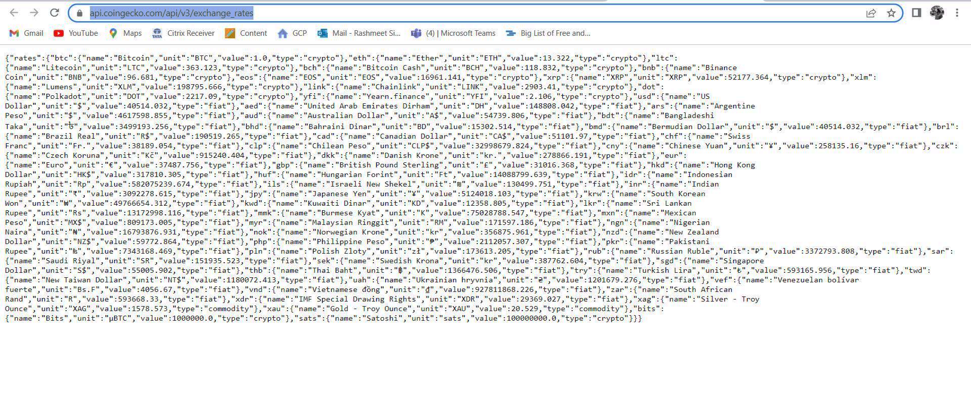
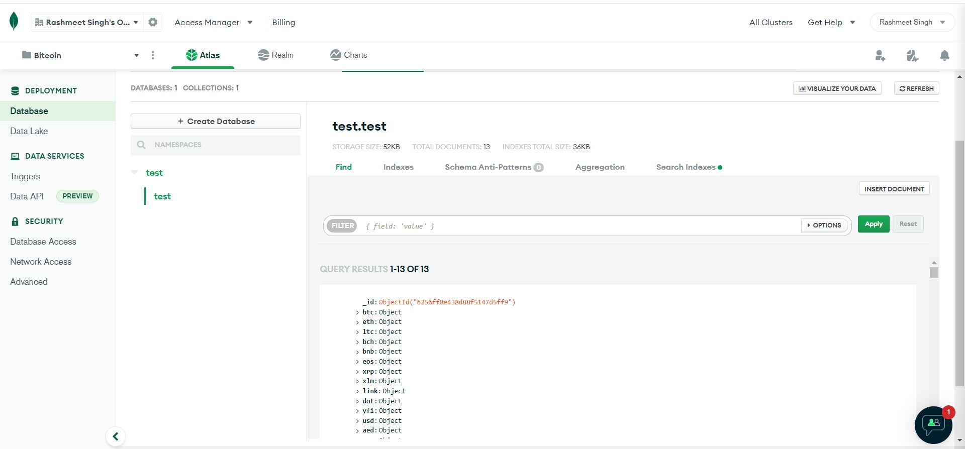
Get Data From API to MONGO Client Cluster

Slide 7
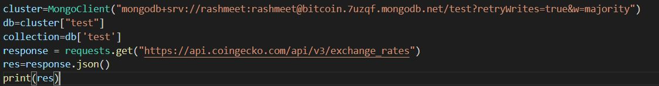
Load Data Into Python From API

Slide 8
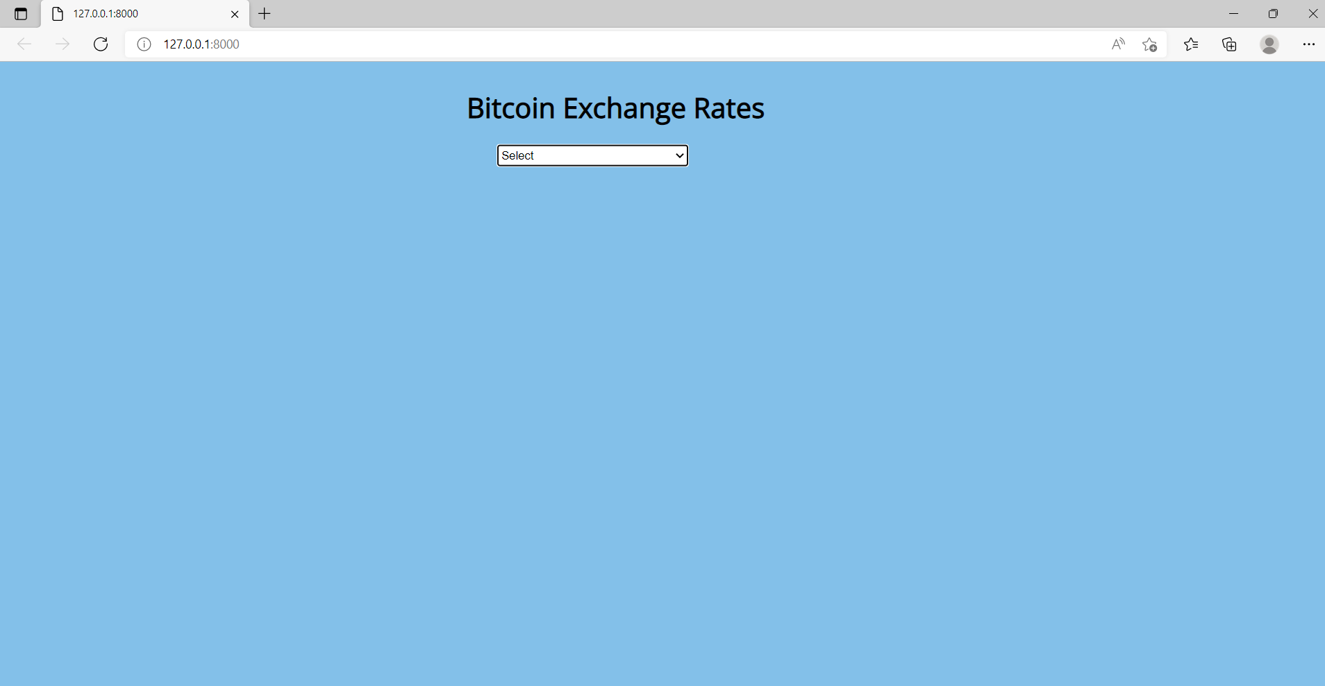
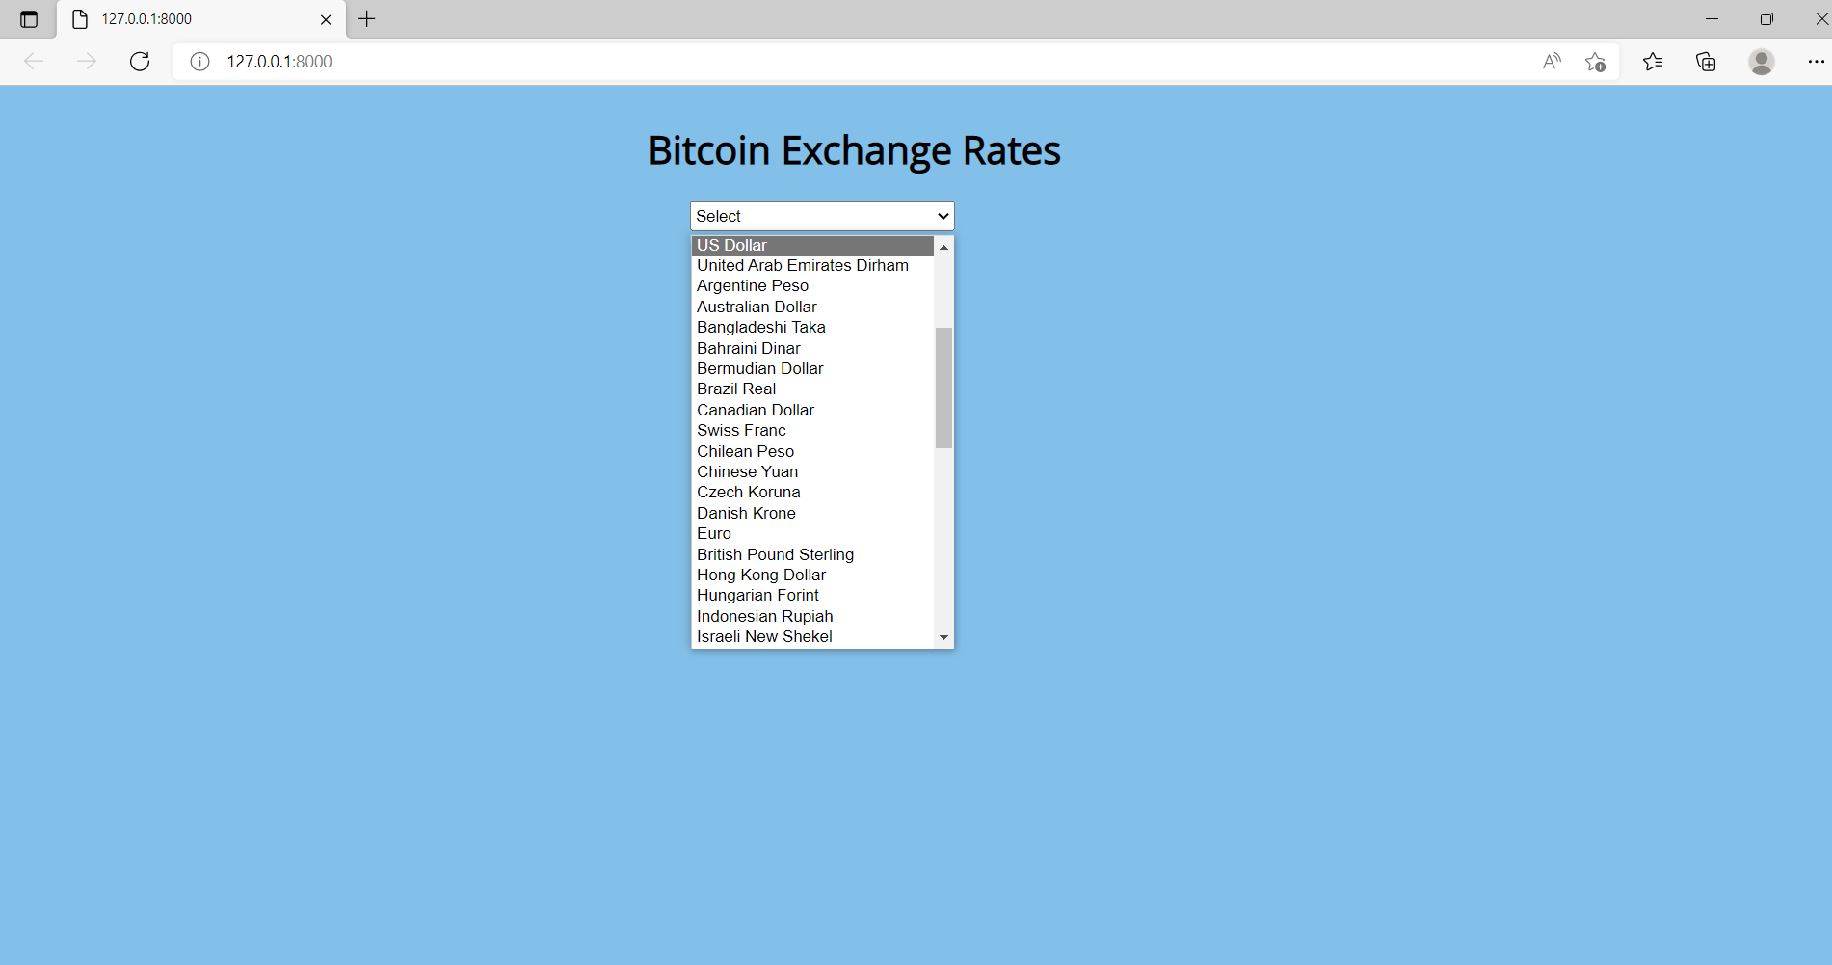
DJANGO WEB APPLICATION (Localhost)

Slide 9
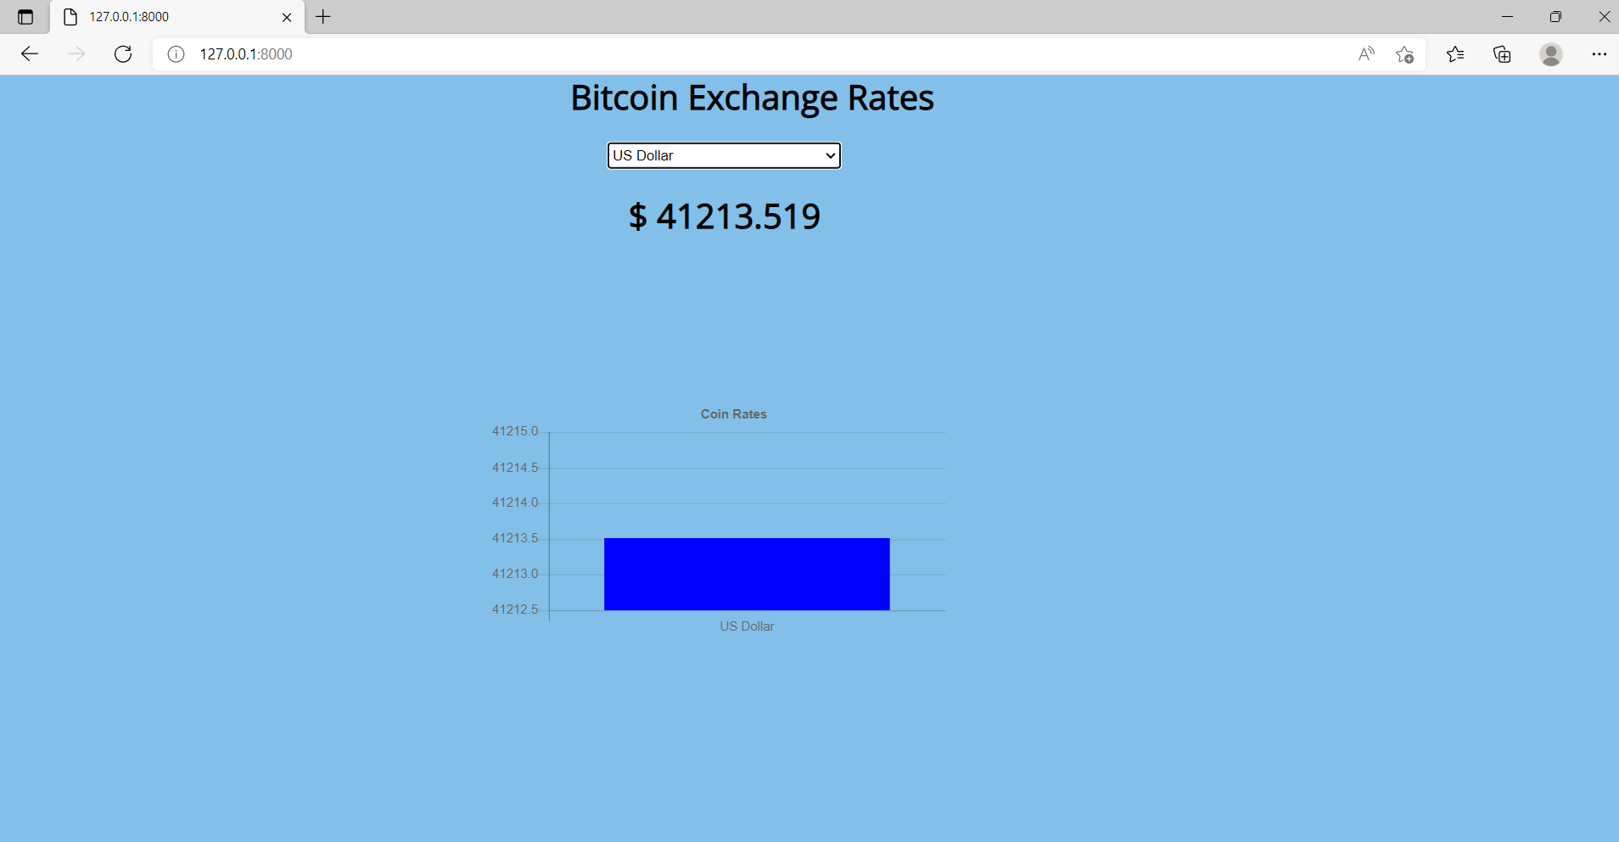
BITCOIN IN US DOLLAR
We are comparing Bitcoin to US dollars in this piece. It will be simple to determine what the price of the US dollar is since the price of the bitcoin in US dollars will be shown differently each time the programme is launched because the quantity will fluctuate according to market buying and selling.

Slide 10
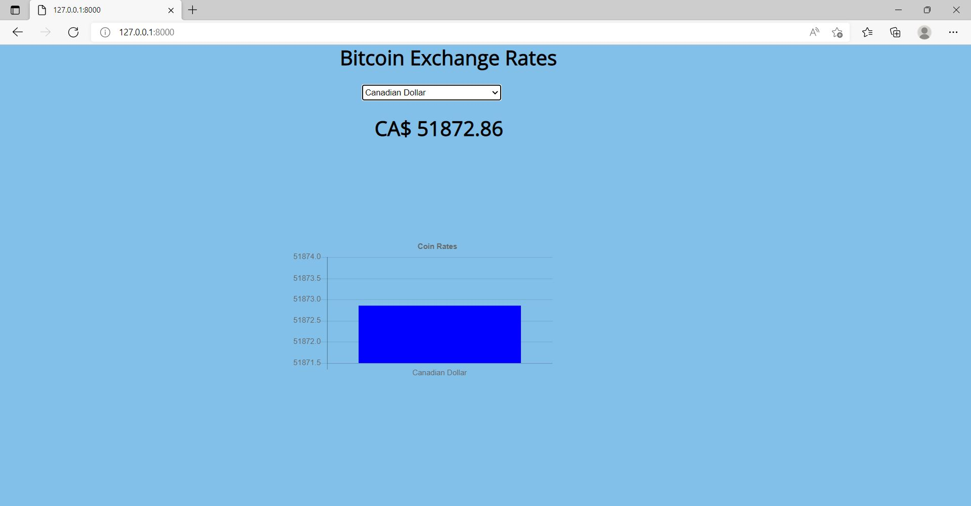
BITCOIN IN CANADIAN DOLLAR(CAD)
The price of bitcoin in Canadian dollars is shown in this section. As illustrated, the price of one Bitcoin in Canadian dollars is about 51,872.86 Canadian dollars.

Slide 11
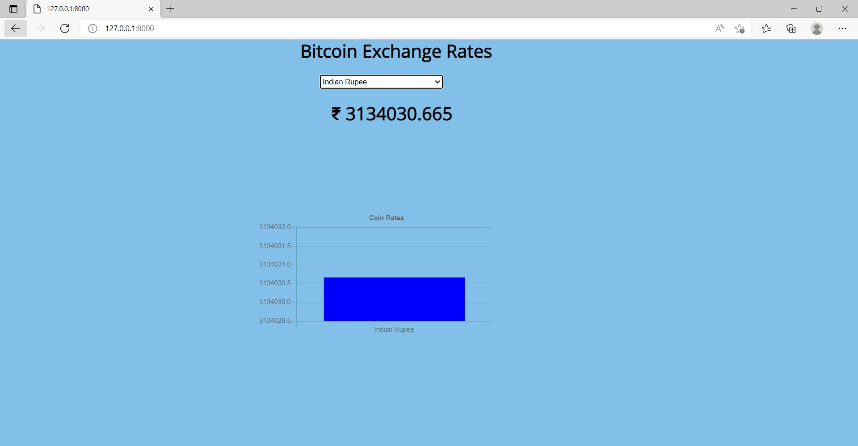
BITCOIN IN INDIAN RUPEE
In this post, we will look at the price of bitcoin in Indian Rupees. As illustrated, the price of one Bitcoin in Indian rupees is about 31,34030.665 Indian rupees.

Slide 12
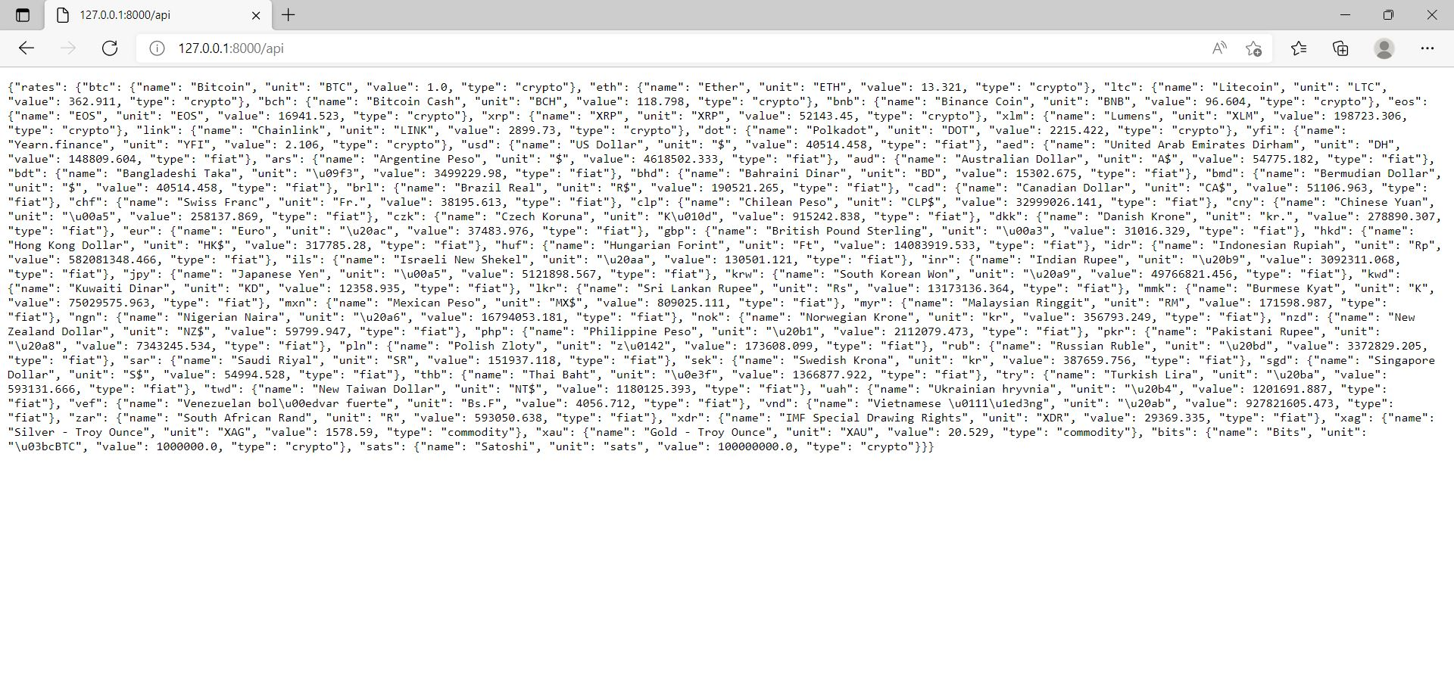
Creating An API that fetches live data from the cloud database
https://bitcoin-exchangerate.herokuapp.com/api

Slide 13
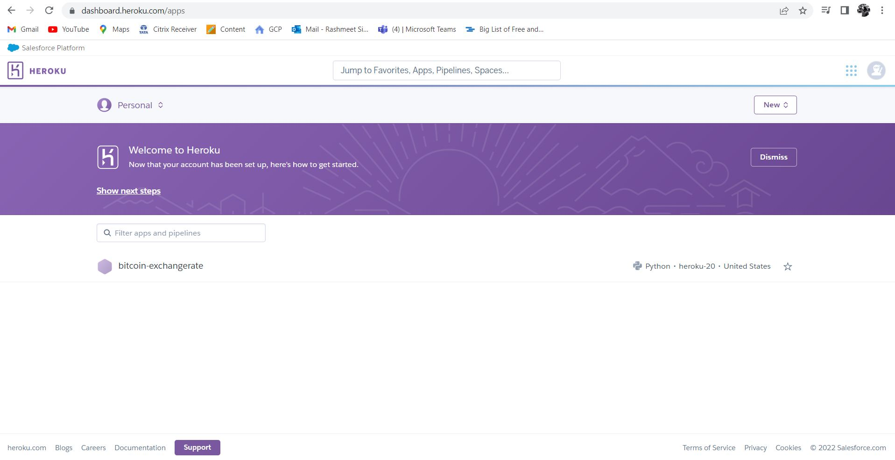
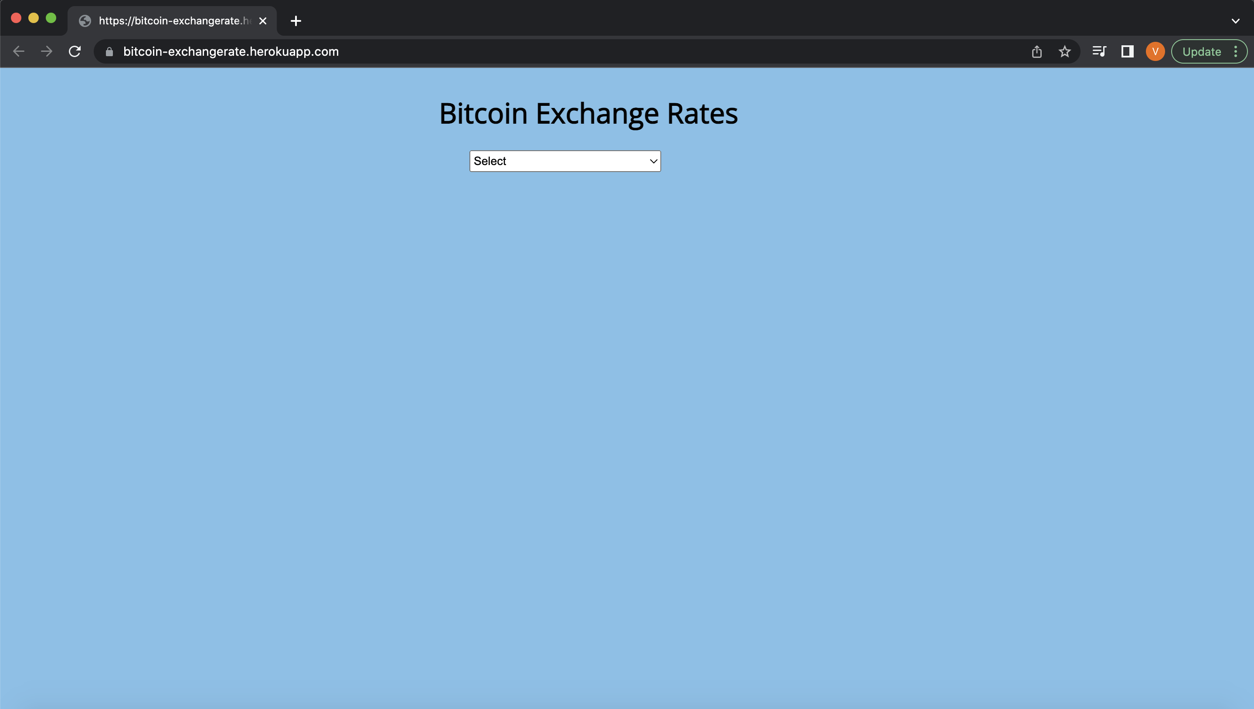
Deployed app on Heroku App.

Slide 14
Fit Gap Analysis
This Application developed fetches data from the API and uses cloud data base(Mongo db.) to store data
Current: Display value of Bitcoin in different world currencies and cryptos.
Ideal: Display and compare values of different crypto in world wide currencies.

Slide 15
References
https://mixedanalytics.com/blog/list-actually-free-open-no-auth-needed-apis/
https://api.coingecko.com/api/v3/exchange_rates

Slide 16
Thank you!

